Slide 1


Robert Muigai Ngechu
08/06/2025

Slide 2

Outline
Executive Summary
Introduction
Methodology
Results
Conclusion
Appendix

Slide 3
Executive Summary
This project predicts the success of SpaceX's Falcon 9 first-stage landings, utilizing real-world launch data. By analysing factors influencing landing outcomes, the goal is to enhance launch cost efficiency and provide competitive insights.
Methodology Summary
Data Collection: Utilized RESTful APIs and web scraping to gather Falcon 9 launch data.
Data Wrangling: Processed and cleaned data for analysis.
Exploratory Data Analysis (EDA): Employed SQL and Python for data exploration and visualization.
Predictive Modeling: Developed classification models (SVM, Decision Trees, Logistic Regression) to predict landing success.
Dashboard Development: Created interactive dashboards using Plotly Dash and Folium for data visualization.
Summary of Results
Cleaned and structured Falcon 9 launch data
Identified key success factors (e.g., launch site, payload)
Found trends: heavier payloads = lower success
Built models with up to 87% accuracy
Delivered interactive dashboard for predictions

Slide 4
Introduction
Predicting Falcon 9 first-stage landing success using SpaceX launch data.
Project Background
SpaceX aims to reduce launch costs through booster reuse. Landing success is key to this goal.
Key Questions
What factors affect landing success?
Can we predict landing outcomes accurately?

Slide 5

Section 1

Slide 6
Methodology
Executive Summary
Data collection methodology:
Perform data wrangling
Describe how data was processed
Perform exploratory data analysis (EDA) using visualization and SQL
Perform interactive visual analytics using Folium and Plotly Dash
Perform predictive analysis using classification models
How to build, tune, evaluate classification models

Slide 7
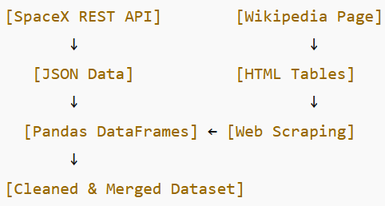
Data Collection
Data was collected using SpaceX Launch API and web scraping from Wikipedia. Launch records were stored, cleaned, and structured for analysis.
Data Collection Process
Key Phrases:
REST API Access – Retrieved SpaceX launch data from public API
Web Scraping (Wikipedia) – Collected supplemental data on launches
JSON to DataFrame – Converted raw data into structured format
Data Storage – Stored and processed using Pandas for analysis
Flowchart

Slide 8
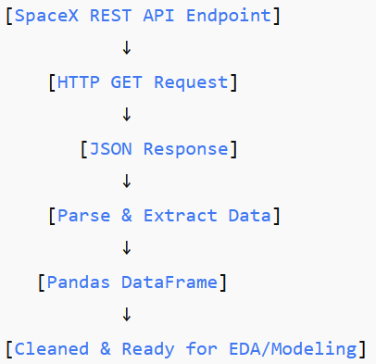
Data Collection – SpaceX API
Present your data collection with SpaceX REST calls using key phrases and flowcharts
Key Phrases:
API Endpoint Access – Retrieved launch data from SpaceX RESTful API
HTTP GET Requests – Fetched JSON responses for each launch
Data Parsing – Extracted relevant fields (launch date, site, payload, outcome)
DataFrame Conversion – Transformed JSON data into Pandas DataFrame for analysis
Place your flowchart of SpaceX API calls here

Slide 9
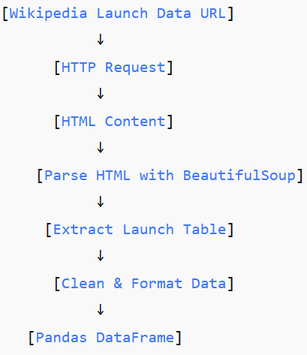
Data Collection - Scraping
Web Scraping Process
Key Phrases:
Target URL Identification – Selected SpaceX launch data page on Wikipedia
HTTP Request – Sent request to retrieve HTML content
HTML Parsing – Used BeautifulSoup to parse HTML tables
Data Extraction – Extracted launch records and relevant fields
Data Cleaning – Removed inconsistencies and formatted data
DataFrame Conversion – Stored cleaned data into Pandas DataFrame

Slide 10
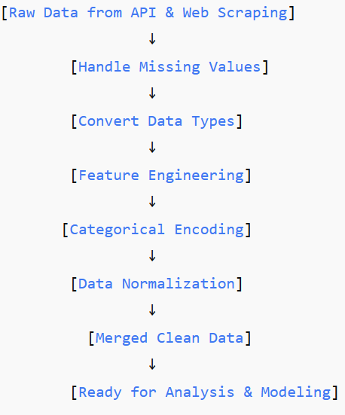
Data Wrangling
Key Phrases:
Handling Missing Values – Imputed or removed incomplete data
Data Type Conversion – Converted columns to appropriate types (e.g., dates, categories)
Feature Engineering – Created new variables (e.g., success flag, payload groups)
Categorical Encoding – Transformed categorical data into numerical format
Data Normalization – Scaled features for consistent range
Merged Datasets – Combined API and scraped data into unified DataFrame

Slide 11
.
EDA with Data Visualization
Charts Plotted & Their Purpose
Bar Charts To compare landing success rates across different launch sites and booster versions.
Histograms To visualize the distribution of payload masses and identify common ranges.
Scatter Plots To explore relationships between payload mass and landing outcomes.
Pie Charts To show the proportion of successful vs. failed landings.
Box Plots To detect outliers and compare payload mass across different orbit types.
Heatmaps To visualize correlations between features affecting landing success

Slide 12
EDA with SQL
SQL Queries Summary
Retrieved total launches and success counts by launch site
Filtered launches by orbit type to analyze success rates
Grouped payload mass ranges and calculated average landing outcomes
Joined multiple tables to combine launch details with booster info
Selected launches with reused boosters to compare success vs. new boosters
Calculated success rate trends over time (by year or mission number)

Slide 13
Build an Interactive Map with Folium
Folium Map Objects & Purpose
Markers Placed at each launch site to identify locations of Falcon 9 launches.
Circles
Used to show launch site areas with sizes representing number of launches or success rates.
Circle Markers Colored by landing outcome (success/failure) for quick visual distinction.
Lines / Polylines Connected launch sites to landing zones to illustrate flight paths and booster recovery routes.
Popups and Tooltips Added interactive info (e.g., launch date, payload mass) on markers for user engagement.
These objects help visualize spatial data, making patterns and relationships easier to understand.

Slide 14
Build a Dashboard with Plotly Dash
Dashboard Plots & Interactions
Landing Success Rate Bar Chart Visualizes success rates by launch site for quick comparison.
Payload Mass Scatter Plot Shows relationship between payload mass and landing outcome.
Orbit Type Pie Chart Displays distribution of launches by orbit category.
Launch Timeline Line Graph Tracks success trends over time.
Interactive Filters (Dropdowns, sliders) Allow users to select launch site, orbit type, and payload range to customize views.
Hover Tooltips and Clickable Elements Provide detailed info on data points for deeper insights.
These elements enhance user engagement, making it easy to explore key factors influencing Falcon 9 landing success.

Slide 15
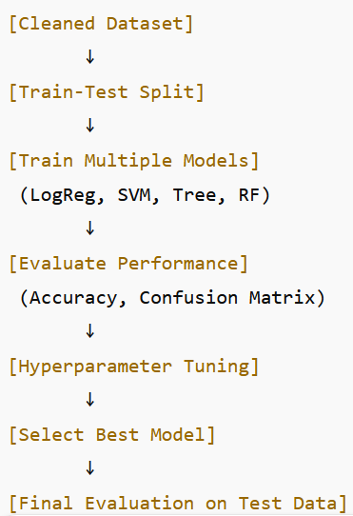
Predictive Analysis (Classification)
Model Development Process
Key Phrases:
Data Split – Divided dataset into training and test sets
Model Selection – Tried multiple classifiers: Logistic Regression, SVM, Decision Tree, Random Forest
Training – Fit models on training data
Evaluation – Used accuracy, precision, recall, and confusion matrix
Hyperparameter Tuning – Applied GridSearchCV to improve model performance
Best Model Selection – Chose model with highest accuracy and generalization

Slide 16
Results

Slide 17

Section 2

Slide 18
Flight Number vs. Launch Site
Show a scatter plot of Flight Number vs. Launch Site
Show the screenshot of the scatter plot with explanations

Slide 19
Payload vs. Launch Site
Show a scatter plot of Payload vs. Launch Site
Show the screenshot of the scatter plot with explanations

Slide 20
Success Rate vs. Orbit Type
Show a bar chart for the success rate of each orbit type
Show the screenshot of the scatter plot with explanations

Slide 21
Flight Number vs. Orbit Type
Show a scatter point of Flight number vs. Orbit type
Show the screenshot of the scatter plot with explanations

Slide 22
Payload vs. Orbit Type
Show a scatter point of payload vs. orbit type
Show the screenshot of the scatter plot with explanations

Slide 23
Launch Success Yearly Trend
Show a line chart of yearly average success rate
Show the screenshot of the scatter plot with explanations

Slide 24
All Launch Site Names
Find the names of the unique launch sites
Present your query result with a short explanation here

Slide 25
Launch Site Names Begin with 'CCA'
Find 5 records where launch sites begin with `CCA`
Present your query result with a short explanation here

Slide 26
Total Payload Mass
Calculate the total payload carried by boosters from NASA
Present your query result with a short explanation here

Slide 27
Average Payload Mass by F9 v1.1
Calculate the average payload mass carried by booster version F9 v1.1
Present your query result with a short explanation here

Slide 28
First Successful Ground Landing Date
Find the dates of the first successful landing outcome on ground pad
Present your query result with a short explanation here

Slide 29
Successful Drone Ship Landing with Payload between 4000 and 6000
List the names of boosters which have successfully landed on drone ship and had payload mass greater than 4000 but less than 6000
Present your query result with a short explanation here

Slide 30
Total Number of Successful and Failure Mission Outcomes
Calculate the total number of successful and failure mission outcomes
Present your query result with a short explanation here

Slide 31
Boosters Carried Maximum Payload
List the names of the booster which have carried the maximum payload mass
Present your query result with a short explanation here

Slide 32
2015 Launch Records
List the failed landing_outcomes in drone ship, their booster versions, and launch site names for in year 2015
Present your query result with a short explanation here

Slide 33
Rank Landing Outcomes Between 2010-06-04 and 2017-03-20
Rank the count of landing outcomes (such as Failure (drone ship) or Success (ground pad)) between the date 2010-06-04 and 2017-03-20, in descending order
Present your query result with a short explanation here

Slide 34

Section 3

Slide 35
<Folium Map Screenshot 1>
Replace <Folium map screenshot 1> title with an appropriate title
Explore the generated folium map and make a proper screenshot to include all launch sites’ location markers on a global map
Explain the important elements and findings on the screenshot

Slide 36
<Folium Map Screenshot 2>
Replace <Folium map screenshot 2> title with an appropriate title
Explore the folium map and make a proper screenshot to show the color-labeled launch outcomes on the map
Explain the important elements and findings on the screenshot

Slide 37
<Folium Map Screenshot 3>
Replace <Folium map screenshot 3> title with an appropriate title
Explore the generated folium map and show the screenshot of a selected launch site to its proximities such as railway, highway, coastline, with distance calculated and displayed
Explain the important elements and findings on the screenshot

Slide 38

Section 4

Slide 39
<Dashboard Screenshot 1>
Replace <Dashboard screenshot 1> title with an appropriate title
Show the screenshot of launch success count for all sites, in a piechart
Explain the important elements and findings on the screenshot

Slide 40
<Dashboard Screenshot 2>
Replace <Dashboard screenshot 2> title with an appropriate title
Show the screenshot of the piechart for the launch site with highest launch success ratio
Explain the important elements and findings on the screenshot

Slide 41
<Dashboard Screenshot 3>
Replace <Dashboard screenshot 3> title with an appropriate title
Show screenshots of Payload vs. Launch Outcome scatter plot for all sites, with different payload selected in the range slider
Explain the important elements and findings on the screenshot, such as which payload range or booster version have the largest success rate, etc.

Slide 42

Section 5

Slide 43
Classification Accuracy
Visualize the built model accuracy for all built classification models, in a bar chart
Find which model has the highest classification accuracy

Slide 44
Confusion Matrix
Show the confusion matrix of the best performing model with an explanation

Slide 45
Conclusions
Point 1
Point 2
Point 3
Point 4
…

Slide 46
Appendix
Include any relevant assets like Python code snippets, SQL queries, charts, Notebook outputs, or data sets that you may have created during this project

Slide 47


